Slide 1
The Development Response to Drug Trafficking in Africa: A Programming Guide
Brooke Stearns Lawson, USAID Africa Bureau/USDA Transnational Organized Crime Advisor
April 29, 2013

Slide 2
Background to
Programming Guide
Drug trafficking an increasing threat to development in Africa
Programming guidance to understand the relationship between drug trafficking and development assistance and mitigate negative impacts
Case studies in Ghana, Kenya, the Mano River sub-region (Guinea, Sierra Leone, and Liberia), and Mozambique
Research focus on heroin and cocaine trafficking

Slide 3
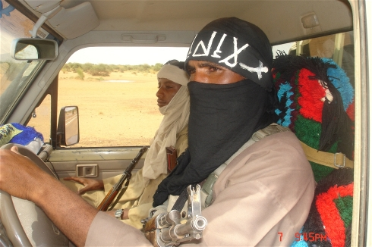
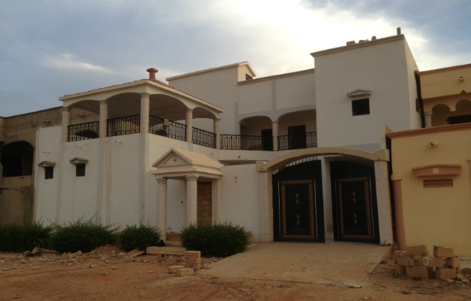
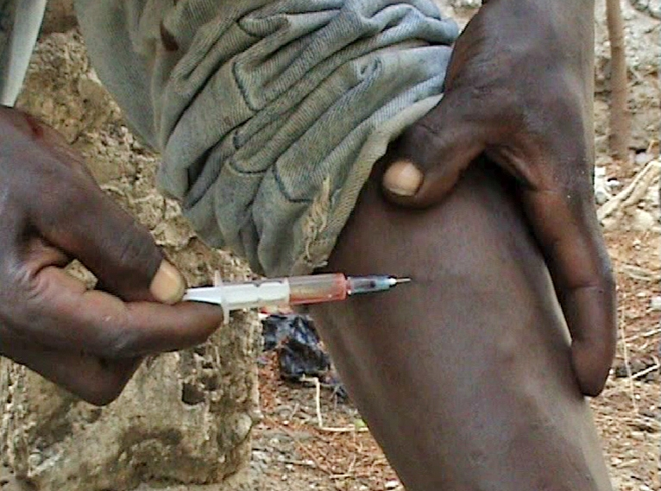
1) Drug Trafficking Threatens Development
Threats to Stability
Corrosion of Governance
Socio-Economic Impacts

Slide 4
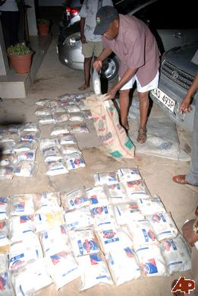
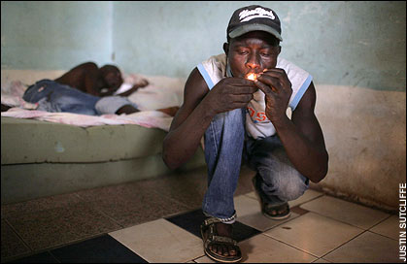
2) Development Practitioners Must “Get Smart” on the Issue
Scope and Scale of Problem
Political Economy Analysis
Type of Approach(es)

Slide 5
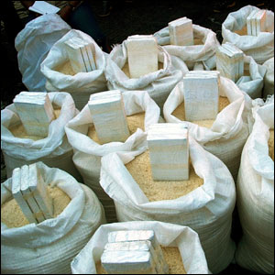
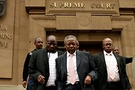
3) Interdiction Alone Will Not Solve the Problem

Slide 6
4) Early Identification of the Problem and Prevention Efforts Are Critical
Economic Impact
Enact anti-money laundering legislation
Strengthen banking, real estate and other regulations and oversight
Build capacity among Financial Intelligence Units and law enforcement to analyze, target and trace financial flows
Build prosecutorial capacity to freeze and seize assets and to obtain conviction and forfeitures
Foster business development through regulatory and financial reform
Drug Use
Support clinics to treat problematic drug use
Promote education to reduce demand
Foster inclusion and reduce marginalization
Violence
Support gang prevention and rehabilitation
Foster community-based citizen security
Support community policing

Slide 7
5) Political Will Must Drive The Approach
 |  | Level of Corruption/Infiltration
 |  | Low-level Officials | High-level Officials
Opposition within Government | Strong: High-level officials oppose state involvement in trafficking | Best scenario for direct interventions | Direct interventions possible but potentially destabilizing
 | Weak: Relatively few high-level officials oppose state involvement in trafficking | Direct interventions most effective when combined with increased political pressure | Direct interventions not advisable

Slide 8
6) Resources Influence Programming Options
Unintended Consequence | Mitigation Approach
Local government capacity building bolsters power of complicit officials | Improve transparency or avoid local areas with known complicit officials
Parliamentary transparency efforts dissuade opposition to drug trafficking | Allow private voting for drug trafficking issues
Trade infrastructure development facilitates the movement of illicit goods | Include trade regulation and controls as part of infrastructure development
Efforts to reduce barriers to trade facilitate the movement of illicit goods | Identify risks and mitigation strategies with business community and transportation professionals
Transportation of development goods is also utilized to move illicit goods | Consider transportation methods and inspection of cargo
Emerging payment systems facilitate the movement of drug money | Ensure emerging payment systems are covered by anti-money laundering regulation and entail proper supervision
Drug traffickers capture humanitarian assistance | Require partners to develop and implement risk mitigation measures

Slide 9
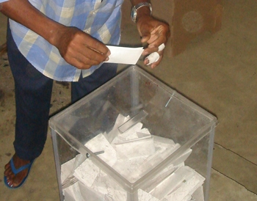
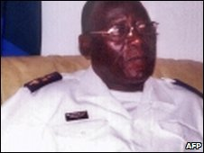
7) Change Presents Windows of Opportunity and Vulnerability

Slide 10
8) Coordination Increases Impacts
Bolster Political Will
Reduce tolerance through research, media
Strengthen community mobilization/civil society advocacy
Apply diplomatic pressure
Foster Accountable Governance
Streamline and improve oversight of customs, security and justice operations
Strengthen accountability
Increase transparency
Create professional government
Raise political standards
Promote checks and balances through improved electoral systems
Develop Counternarcotics Capacity
Improve legislative framework
Strengthen judicial and security institutions

Slide 11
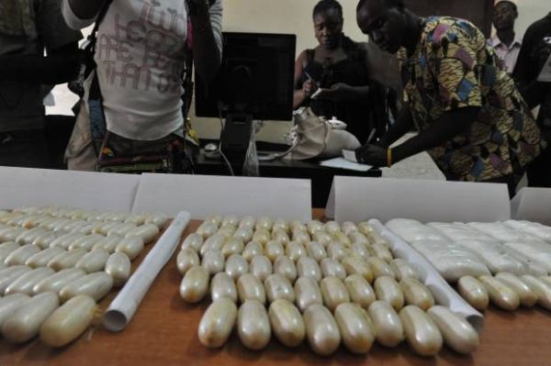
Questions? Comments?

