Slide 1
ECOWAS POLICY AND STRATEGY TO ADDRESS THE IMPACT OF DRUG TRAFFICKING ON GOVERNANCE, SECURITY AND DEVELOPMENT IN WEST AFRICA
Presented by the Commissioner for Human Development and Gender
Dr Adrienne DIOP

Slide 2
PRESENT SITUATION
West Africa has become a hub for cocaine trafficking from South America to Europe
West African international airports have become major redistribution exit points towards the new cocaine markets of Europe, South Africa and the Middle East

Slide 3
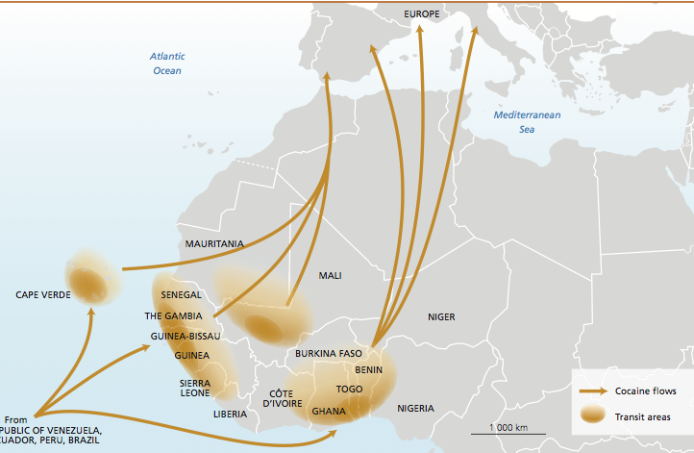
COCAINE VIA ANDES TO WEST AFRICA source UNDOC 2013
Notes:
UNODC Report / TRANSNATIONAL ORGANIZED CRIME IN WEST AFRICA: A THREAT ASSESSMENT, February 2013

Slide 4
PRESENT SITUATION
European law enforcement records show that West African account for 90 % of all africans arrested for drug trafficking
Countries most concerned : Benin, Cape Verde, Gambia, Ghana, Guinea, Guinea Bissau, Senegal, Nigeria, Mauritania

Slide 5
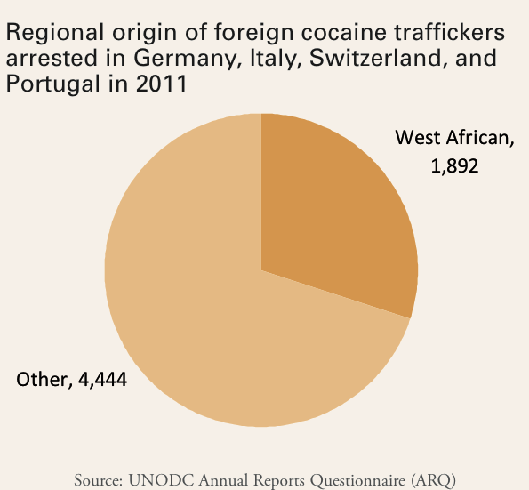

Slide 6
PRESENT SITUATION
Local Consumption has grown rapidly with up to 2.5 million drug users.
Globally, UNODC estimates that between 155 and 250 million people (3.5 to 5.7% of the population aged 15 – 64) used illicit substances at least once in 2008 with cannabis users comprising the largest number of illicit drug users.

Slide 7
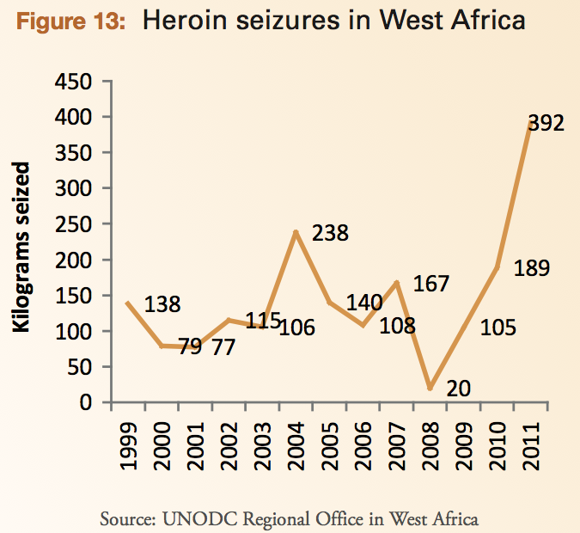

Slide 8
CAUSE OF ILLICIT DRUG TRAFFICKING IN WEST AFRICA
Tightening of border controlls in some EU countries
Reinforcement of security in the US after september 11
Growing success against traffickers by law enforcement agencies in Europe and the Caribbean
South American traffickers forced to use other routes to reach the European market
Best route found : through West Africa

Slide 9
CAUSE OF ILLICIT DRUG TRAFFICKING IN WEST AFRICA
WHY WEST AFRICA ?
Advantageous location of West Africa
Relatively short distance between South America and West Africa and between West Africa and Europe

Slide 10
CAUSE OF ILLICIT DRUG TRAFFICKING IN WEST AFRICA
WHY WEST AFRICA ?
Countries have porous borders and have difficulty in controlling their territory
Countries have poor law enforcement structures
Vulnerability of countries to organised crime
Countries have corruption practices

Slide 11
CAUSE OF ILLICIT DRUG TRAFFICKING IN WEST AFRICA
WHY WEST AFRICA ?
Security forces lack resources and are poorly equipped (few cars, few radios) and trained
Limited financial resources to man institutions and underpaid security personnel
Efficiency of the Justice system is often questionned

Slide 12
HOW DRUG IS TRAFFICKED
HOW IS IT DONE ?
By maritime and / or air shipments
Drug traffickers established relay systems along the coast where drugs are received and re-packaged for smuggling into Europe
West African coast with logistic bases equipped with landing strips

Slide 13
HOW DRUG IS TRAFFICKED
HOW IS IT DONE ?
By maritime and / or air shipments
Small quantities of drugs are flown in small planes to West Africa
Larger quantities are put in ships that sail into West African waters where smaller vessels meet them to receive the drugs and move them inland

Slide 14
HOW DRUG IS TRAFFICKED
HOW IS IT DONE ?
By maritime and / or air shipments
Small quantities of drugs are flown in small planes to West Africa
Larger quantities are put in ships that sail into West African waters where smaller vessels meet them to receive the drugs and move them inland

Slide 15
HOW DRUG IS TRAFFICKED
HOW IS IT DONE ?
By maritime and / or air shipments
Once in West Africa the drugs go to Europe through Morocco using fast boats or courriers who swallow or conceal it in their luggage and use commercial flights to Europe

Slide 16
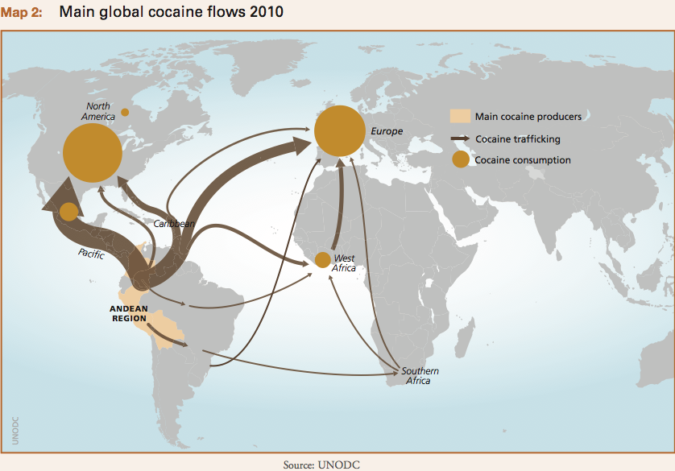

Slide 17
WHAT CONSEQUENCES?
A country that traffics drug is a country that consumes
West african countries will have 3 problems : traffic, production and consumption and development of organised crime

Slide 18
WHAT CONSEQUENCES?
Public Health, HIV/AIDS and social problems
Human trafficking
Security problems (crime, violence,conflicts)
Impact on governance (corruption undermining rule of law) and political stability
Negative Economic impact (unexplained high influx of money )
Corruption and money laundering
Agriculture (cultivation of hashish more profitable than food crops)

Slide 19
WHAT CONSEQUENCES?
Increase of a new class of entrepreneurs (marketing cocaine and cannabis)
The countries that will be more subject to drug trafficking are those already affected by conflicts and economic crises. They are a fertile ground for criminal organisations
Increased organised crime networks

Slide 20
ECOWAS RESPONSE
Adoption in 2008 of the ECOWAS Regional Action Plan against Illicit Drug Trafficking, Abuse and Organised Crimes by ECOWAS Heads of State and Government
A Political Declaration against Illicit Drug Trafficking, Abuse And Organised Crimes was also adopted in 2008 by ECOWAS Heads of State and Government

Slide 21
ECOWAS ACTION PLAN AGAINST DRUG TRAFFICKING
ECOWAS Operational Plan on Illicit Drug Trafficking, Organized Crime and Drug Abuse in West Africa (2009 – 2012) was formulated
The activities to be carried out under this Plan are financed by the EU Commission
Notes:
16 Million euros

Slide 22
ECOWAS ACTION PLAN AGAINST DRUG TRAFFICKING:
5 THEMATIC AREAS
Mobilisation of ECOWAS Political Leadership and need for allocation of adequate national budget by Member States for Preventing and Combating Illicit Drug Trafficking, Related Organised Crimes and Drug Abuse.
Effective Law Enforcement and National/Regional Cooperation Against High Level Increase in Illicit Drug Trafficking, Drug Abuse and Organised Crime

Slide 23
ECOWAS ACTION PLAN AGAINST DRUG TRAFFICKING
5 THEMATIC AREAS
Appropriate and adequate Legal Framework for Effective Criminal Justice Administration.
Facing and Dealing with the Emerging Threats of Increased Drug Abuse and Associated Health and Security Problems.
Valid and Reliable Data to Assess the Magnitude of the Drug Trafficking and Abuse Problems Affecting the Region on a Sustainable Basis

Slide 24
OBJECTVES OF ECOWAS OPERATIONAL PLAN AGAINST DRUG TRAFFICKING
The ECOWAS Commission is strengthened for proper coordination and follow-up of the Regional Action Plan at regional and national level
Regional and national legal frameworks are revised to better respond to threats posed by illicit drug trafficking and organised crime
The ECOWAS Commission is equipped with adequate instruments and tools, and human resources capacities are strengthened in order to provide effective support to law enforcement organisations/institutions in West Africa
The ECOWAS Commission is equipped for collecting data, is able to disseminate reliable information on the magnitude of illicit drug trafficking and abuse problems affecting the region, and can support regional crime prevention activities

Slide 25
IMPLEMENTING ECOWAS OPERATIONAL PLAN
ECOWAS Commission Activities
The ECOWAS Commission in collaboration with INTERPOL successfully organized a Joint Police Simultaneous Operations in the Benin/Togo/Ghana borders, sea and airports in 2012 in which a total of about 8 tons of illicit drugs were seized.
Provision of support to Inter-Ministerial Drug Coordinating Committees in Member States to enhance capacities to address the drug menace

Slide 26
IMPLEMENTING ECOWAS OPERATIONAL PLAN
ECOWAS Commission Activities
Revision of Regional and National Legal Frameworks to better respond to threats posed by illicit drug trafficking and organised crimes.
Establishment of functional data collection system on drug abuse and organized crimes trends for planning and advocacy purposes
Notes:
Set up epidemiological research networks on drug abuse at regional and national levels, the WENDU Project

Slide 27
IMPLEMENTING THE OPERATIONAL PLAN
ECOWAS Commission Activities
Strengthen the Internal Capacities of the ECOWAS Commission Drug Unit and ensure inter-disciplinary collaboration with the relevant departments of Peace-keeping Operations and Regional Security and Legal Affairs of the ECOWAS the Commission.
Notes:
Recruitment under way (ecowas budget and EU funding)

Slide 28
COOPERATION WITH PARTNERS
The ECOWAS Commission consistently maintains dialogue and cooperation with relevant United Nations agencies and institutions such as the UNODC, DPA, DPKO, INTERPOL, and UNOWA on drugs issues, based on their expertise, commitment and mandates.

Slide 29
COOPERATION WITH PARTNERS
The West Africa Coast Initiative (WACI) with UNODC/ UNOWA/DPA/DPKO and INTERPOL
Support to Guinea Interministerial Drug Coordination Committee with the support of the Government of Japan
Establishment of Trans National Crime Units to enhance national and international coordination and achieve intelligence based investigations.

Slide 30
COOPERATION WITH PARTNERS
The AIRCORPS Project aims to secure and establish effective communication and exchange of intelligence between Brazil, Cape Verde, Côte d'Ivoire, Ghana, Mali, Nigeria, Senegal and Togo during its first phase.
Country initiatives within the context of the Regional Action Plan . e.g. The Dakar Initiative.

Slide 31
WAY FORWARD
Extension of ECOWAS ACTION Plan to 2015 by the Authority of ECOWAS Head of States in February 2013
Special Plan to support Guinea Bissau in the fight against drug trafficking
Capacity building for formal and informal Education institutions on prevention and reduction of drug abuse
Notes:
Health and education experts from Member States

Slide 32
CONCLUSION
The ECOWAS Commission seeks continued collaboration with its partners and relevant institutions including the West African Drug Commission for increased technical assistance and cooperation in fighting the drug menace in the region on a sustainable basis.
Hope new areas of cooperation will be developped through the West Africa Commission on Drugs (WACD)

Slide 33
Thank you for your kind attention

